Slide 1


Slide 2
Overview of Power BI

Slide 3
Outlines
What is Data Visualization ?
What is Power BI ?
Top 10 features of Power BI
Tableau vs Power BI and MSBI vs Power BI
Power BI Architecture
Power BI Components
On Premise vs Cloud
Workflow of Power BI

Slide 4

Data Visualization
Data visualization is the graphical representation of information and data.
By using visual elements like charts, graphs, and maps, data visualization tools provide an accessible way to see and understand trends, outliers, and patterns in data.
Additionally, it provides an excellent way for employees or business owners to present data to non-technical audiences without confusion.
In the world of Big Data, data visualization tools and technologies are essential to analyze massive amounts of information and make data-driven decisions
Why data visualization is important ?
The importance of data visualization is simple: it helps people see, interact with, and better understand data.
Whether simple or complex, the right visualization can bring everyone on the same page, regardless of their level of expertise

Slide 5
Visualization Tools In Market
Tableau
Power BI
Qlik view
Qlik Sense
Google Charts
Zoho Analytics

Slide 6
What is Power BI ?
Power BI is an interactive data visualization software product developed by Microsoft with a primary focus on business intelligence.
Power BI is a Data Visualization and Business Intelligence tool that converts data from different data sources to interactive dashboards and BI reports.
Power BI provides a scalable platform that helps the user to connect, visualize, and share the data with other users or stakeholders to gain deeper insights into the business.
It is available in both free and paid versions.
Free : Power BI Desktop
Paid : Power BI Service (Power BI Pro , Premium)

Slide 7
Top 10 Features of Power BI
Monthly Product Updates (all)
Extract insights from large datasets
Create custom visualizations with R and Python (all)
Analyze your datasets in Excel (Pro or Premium only)
Create beautiful maps with your data (all)
Easily source and transform data with Power Query (all)
Automatic data refreshes (Pro or Premium only)
Power BI Mobile App (all)
Re-use datasets across different reports and dashboards (Pro or Premium only)
Powerful integration with other Microsoft Products
Notes:
https://corporatefinanceinstitute.com/resources/business-intelligence/top-10-power-bi-features/

Slide 8
Tableau vs Power BI
Tableau | Power BI
Tableau is more expensive than Power BI. The pro version of Tableau costs more than $35 per month per user. | Power BI is a low-cost software. The professional version of Power BI costs less than $10 per month per user.
Tableau can handle a huge volume of data with better performance. | Power BI can handle a limited volume of data. (Power BI Premium handle huge volume of data)
Tableau works best when there is a vast data in the cloud | Power Bl doesn’t work better with a massive amount of data
The information can be stored by using the Tableau server. | Power BI concentrates more on reporting and analytical modeling but not for storing the data.
Tableau deploys MDX for measures and dimensions. | Power BI uses DAX for calculating and measuring columns.
It is suitable for medium-sized and large-sized organizations | It is suitable for small-sized and medium-sized organizations.
Tableau can run on Windows and Mac OS. | Power BI doesn’t run on Mac, it can only run on Windows since it is a Microsoft’s application.

Slide 9
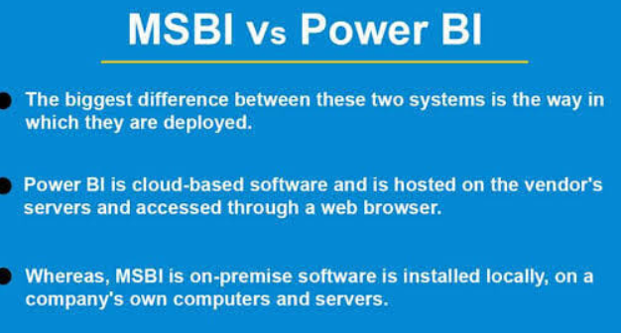
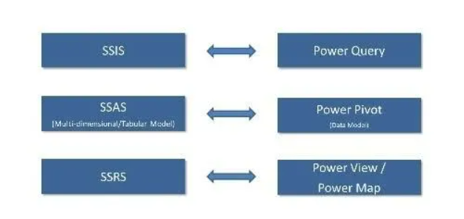
MSBI vs Power BI
MSBI
Power BI
Notes:
https://intellipaat.com/blog/msbi-vs-power-bi-difference/

Slide 10
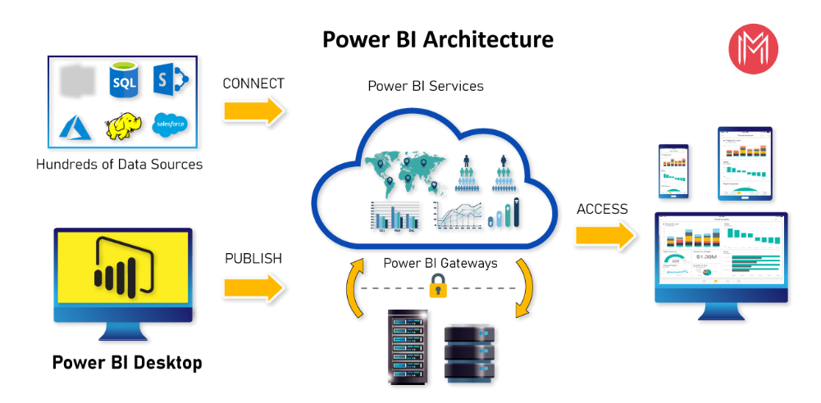
Power BI Architecture
Notes:
https://mindmajix.com/power-bi-architecture

Slide 11
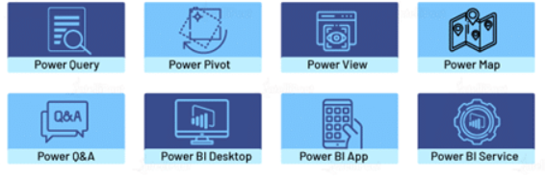
Power BI Desktop Components
Power Query
Power Pivot
Power View
Power Map
Power BI Q&A
Power BI Desktop
Notes:
https://mindmajix.com/power-bi-architecture
https://intellipaat.com/blog/what-is-power-bi/

Slide 12
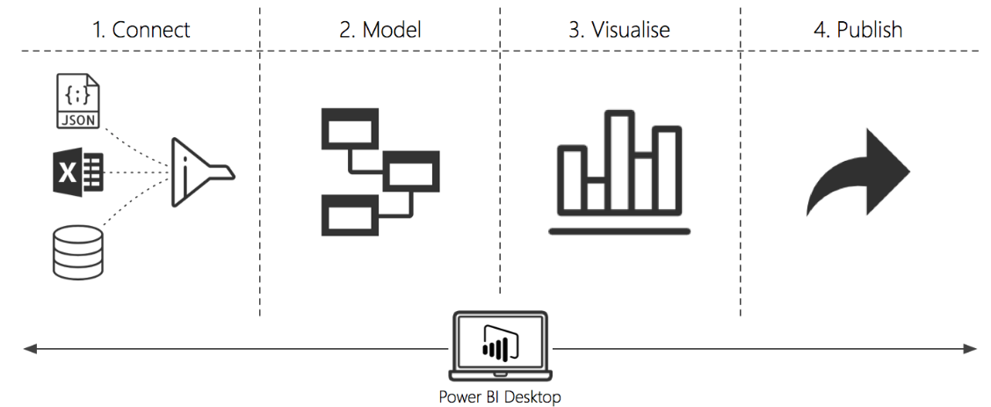
Workflow of Power BI
Data Integration
Data Processing
Data Presentation
Data Publishing
Notes:
https://mindmajix.com/how-to-download-and-install-power-bi-desktop

Slide 13
Power BI Download & Installation

Slide 14
Power BI Download and Installation
Minimum Requirements
Download from Microsoft official website
Installation step by step
Reference : https://powerbi.microsoft.com/en-us/desktop/
Notes:
https://mindmajix.com/how-to-download-and-install-power-bi-desktop

Slide 15
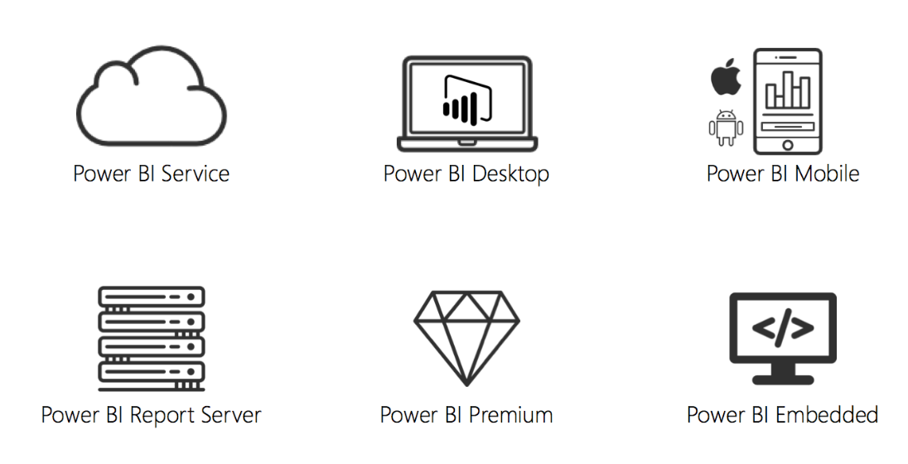
Power BI Family / Products
Reference : https://powerbi.microsoft.com/en-au/power-bi-pro/
Notes:
https://www.taygan.co/blog/2018/06/10/getting-started-with-power-bi

Slide 16
Data Sources and Connectivity modes

Slide 17
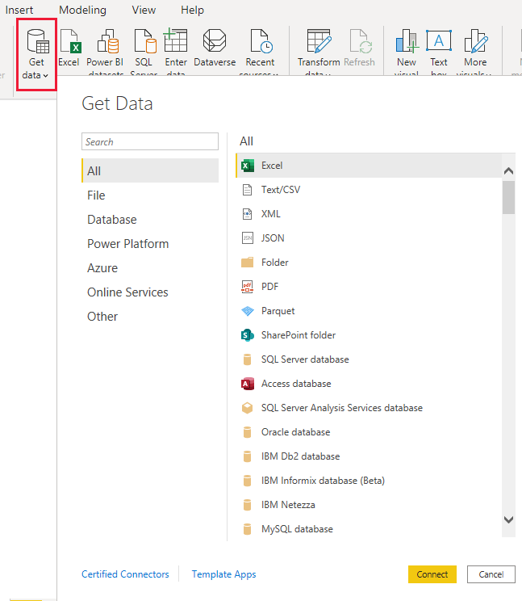
Data Sources in Power BI
File category
Database category
Power Platform category
Azure category
Online Services category
Other categories
Reference : https://learn.microsoft.com/en-us/power-bi/connect-data/desktop-data-sources

Slide 18
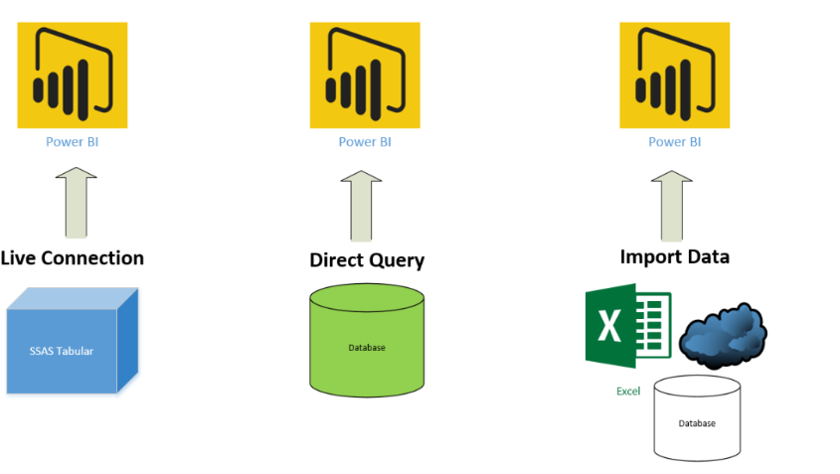
Connectivity Modes
Direct mode (Sql Server)
Import mode (excel, text, sql server)
Live connection (SSAS Tabular, cubes, Azure AS, Power BI datasets)
Composite mode (Direct and Import)
Reference : https://learn.microsoft.com/en-us/power-bi/connect-data/service-dataset-modes-understand

Slide 19
Direct mode vs Import mode vs Live mode
Direct mode | Import mode
It is directly connected to the data source so copy of data will be not loaded into power bi | Import mode loads the copy of data into the power BI desktop
Limited data sources support | All data sources are support
Massive Datasets (Greater than 1 GB) | Datasets of Small and Medium Size Max- 1GB
Each 15 minutes, the report is refreshed | you can schedule up to 8 refreshes each day (more with Premium)
Power query transformations are limited | Import mode supports all power query transformations
Supports minimum DAX functions | Supports all DAX functions
Ex: SQL Server, Oracle, Azure SQL, Redshift , Azure Databricks | Examples : Excel, CSV, Social media, Web URL, CRM data, SQL Server

Slide 20
Direct vs Live
Direct | Live
Data is connected directly to the data source | Data is connected directly to the data source
Power query functionality is there | No power query functionality in Live
You can edit the relationships in Direct query | Cannot edit the relationship
Manage relationship tab is there | Manage relationship tab is greyed out
Measures are limited (ex: you can't write all time intelligence functions) | you can write all measures
you cannot add calculated columns | cannot add calculated columns
Ex: SQL Server, Teradata, Azure SQL, Oracle | Ex: SSAS, AAS, Power BI dataset in service

Slide 21
Power BI Desktop Overview

Slide 22
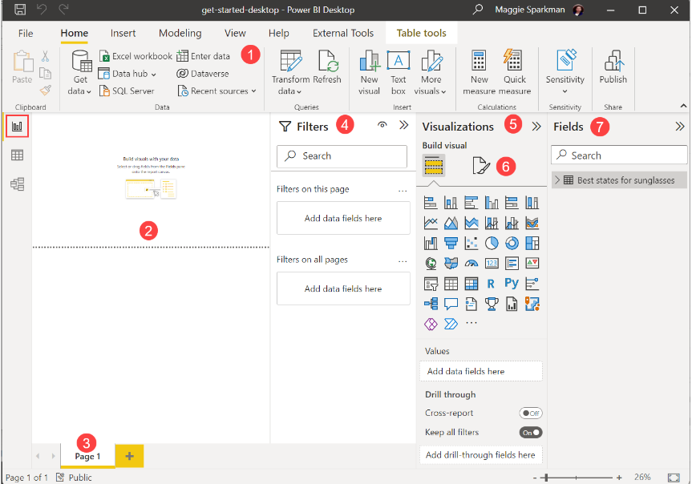
Power BI Desktop Report view
Ribbon
Canvas
Report Page name
Filters pane
Visualization pane
Format pane
Fields pane
Notes:
https://learn.microsoft.com/en-us/power-bi/fundamentals/desktop-getting-started

Slide 23
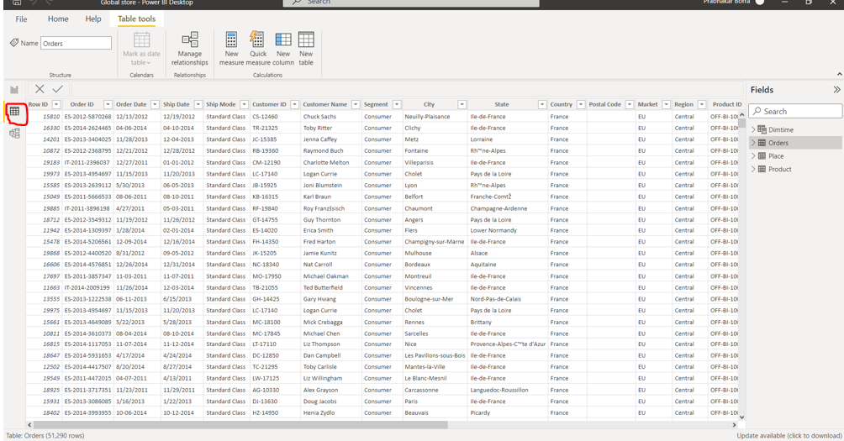
Power BI Desktop Data View / Un Pivot

Slide 24
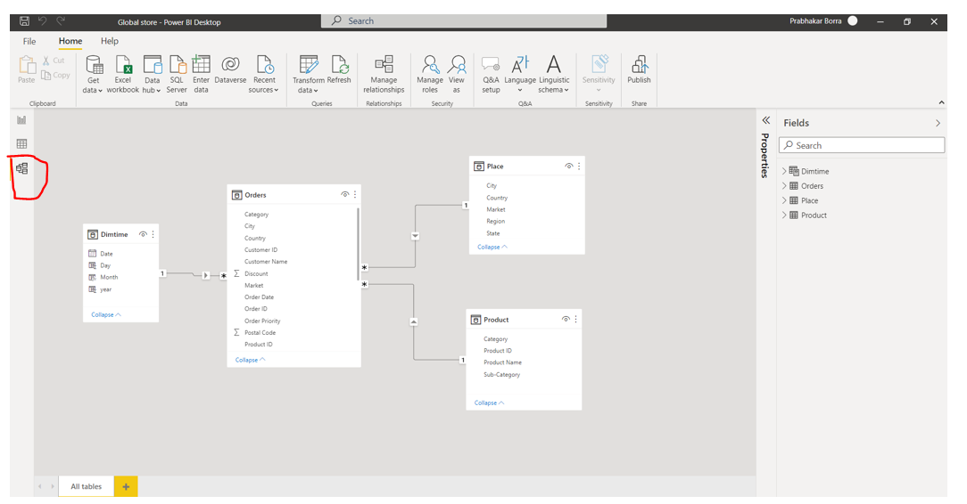
Power BI Desktop Model view /Pivot

Slide 25
Power Query Editor (Transformations)

Slide 26
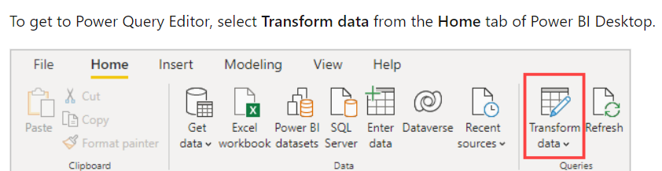
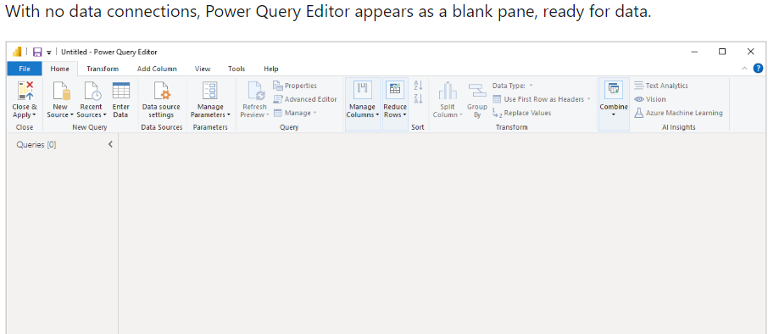
Power Query Editor Overview
Power BI Desktop also comes with Power Query Editor.
Use Power Query Editor to connect to one or many data sources, shape and transform the data to meet your needs, then load that model into Power BI Desktop.
Notes:
https://learn.microsoft.com/en-us/power-bi/transform-model/desktop-query-overview
https://hevodata.com/learn/power-query-power-bi/

Slide 27
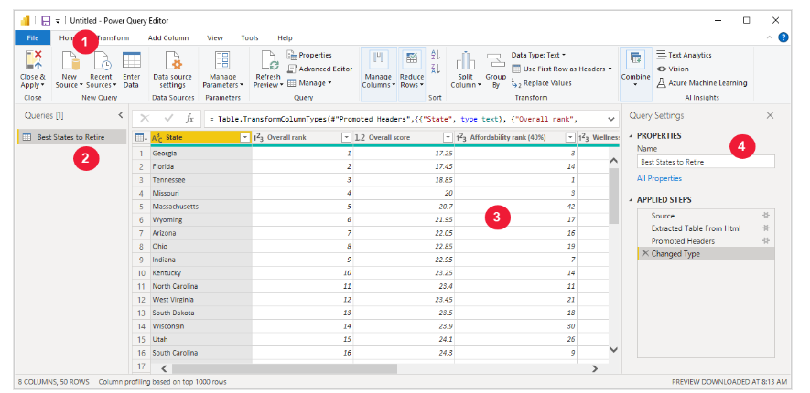
Contd..
Query Editor Preview
Ribbon
many buttons are now active to interact with the data in the query.
Queries Pane
displays the number of active queries and the name of the query
Data View
In the center pane, or Data pane, data from the selected query is displayed.
4. Settings Pane
Query Settings pane, is where all steps associated with a query are displayed.

Slide 28
Query Editor Tabs
Power Query Editor consists of Six tabs: Home, Transform, Add Column, View, Tools, Help
Home : contains the common query tasks. connect to data and begin the query building process
Transform : provides access to common data transformation tasks, such as:
Adding or removing columns
Changing data types
Splitting columns
Other data-driven tasks
Add Column provides more tasks associated with adding a column, formatting column data, and adding custom columns.
View : used to toggle whether certain panes or windows are displayed. It's also used to display the Advanced Editor.
Tools : Used to know the Diagnostic Query status

Slide 29
Query Editor – Home Tab
Close & Apply | Close the query editor window and apply any pending changes
New Source | Create Queries by importing from a new source
Enter Data | Create a new table by typing / Pasting
Manage Parameters | View and modify the parameters
Refresh preview | Refresh specific Query / All Queries
Manage Columns | Go to Specific column / remove columns
Reduce Rows | Choose the rows to keep / remove
Sort | Sort highest to lowest or Lowest to highest
Transform | Replace existing values into new values
Combine | Merge and Append Queries
Split Column | Separate of elements of column into multiple columns

Slide 30
Query Editor – Transform Tab
Transpose | Transpose the tables : Rows as Columns and Columns as Rows
Reverse Rows | Last rows are displayed First
Count Rows | Returns the no. of rows in the table
Data Type | Change the datatype for the selected columns
Rename | Rename the column names
Replace Values | Replace values with new values | Replace errors with new values
Fill | Up and Down
Pivot | Unpivot Column | Change the rows into column | Columns into Rows
Move | Move columns into different positions in the table (Left, Right, Beginning, end)
Convert to List | convert to selected columns into list

Slide 31
Transform tab Contd..
Split Column | Split the column data into multiple columns
Format: | Change the format of data (Lower, Upper, Clean, Trim…..etc)
Merge Columns | Concate the currently selected columns into Single Column
Extract | Extract character values from Text (Length, Range, First characters, Last)
Parse | Extract rows and columns into JSON format
Group By

Slide 32
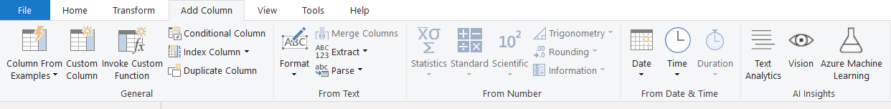
Query Editor – Add column
Column From Examples | To create new column in this current table
Custom Column | Create a new Column in this table based on a custom formula
Invoke Custom Function | defined custom function
Conditional Column | Create a new column with the conditions (if.. elseif... else)
Index Column | Create a new column with an index values
Duplicate Column | Create a new column that duplicates the values

Slide 33
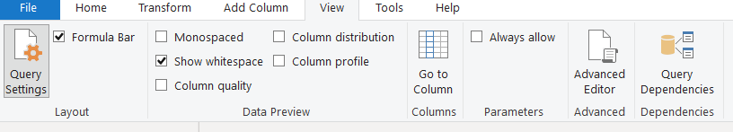
Query Editor - View
Formula Bar | Enable or disable
Data Preview
Parameters | Manage Parameters for Dynamic Filtering
Query Dependencies | View a dependency tree of all queries
Advanced Editor | Advanced Query Editor (M Language)

Slide 34
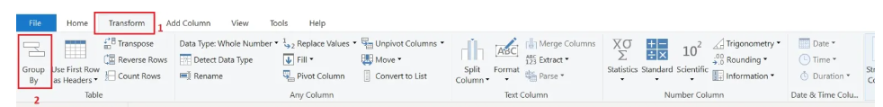
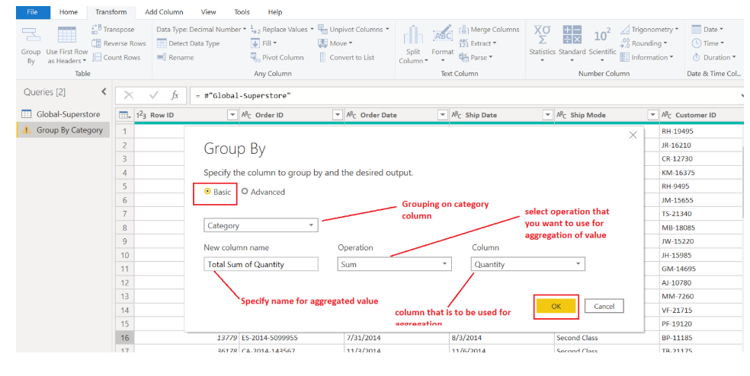
Group By
Group By Single Column
Group by Option
Total Sum of Quantity by Category

Slide 35
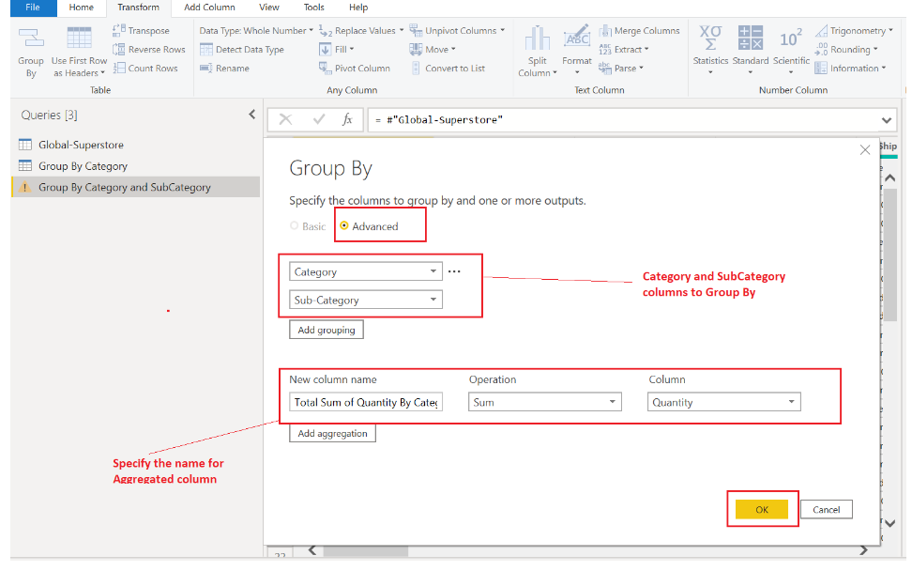
Group by on multiple columns
Total Sum of Quantity By Category and Subcategory.

Slide 36
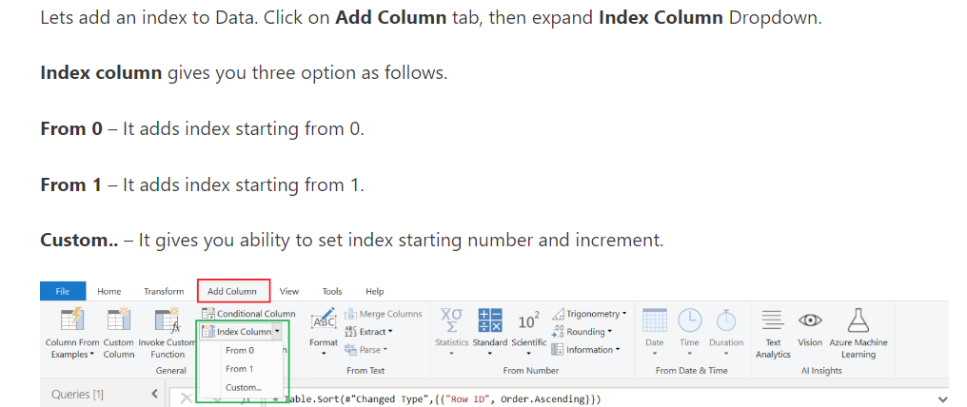
Create Index Column

Slide 37
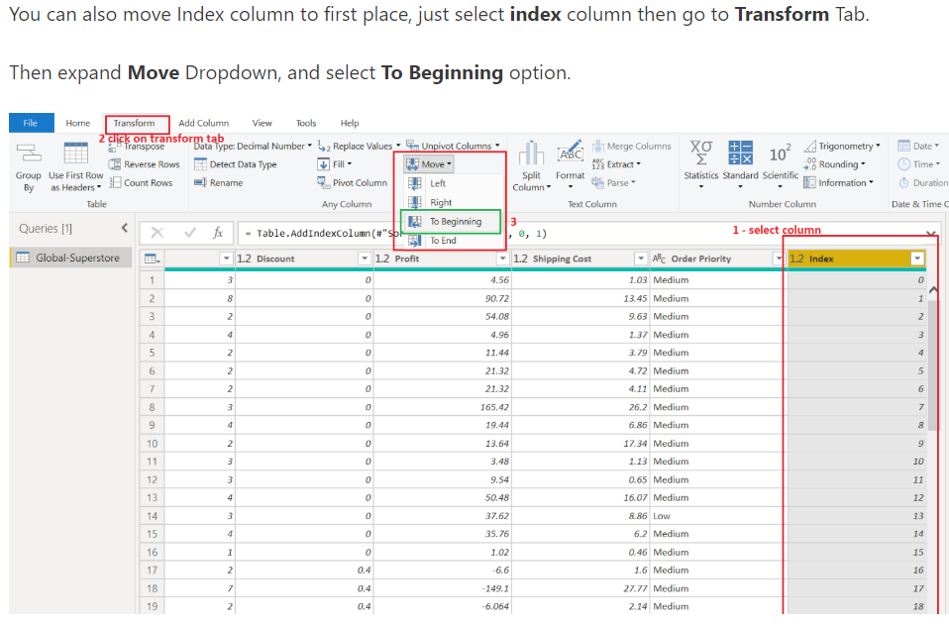
Move to Beginning Index value Column

Slide 38
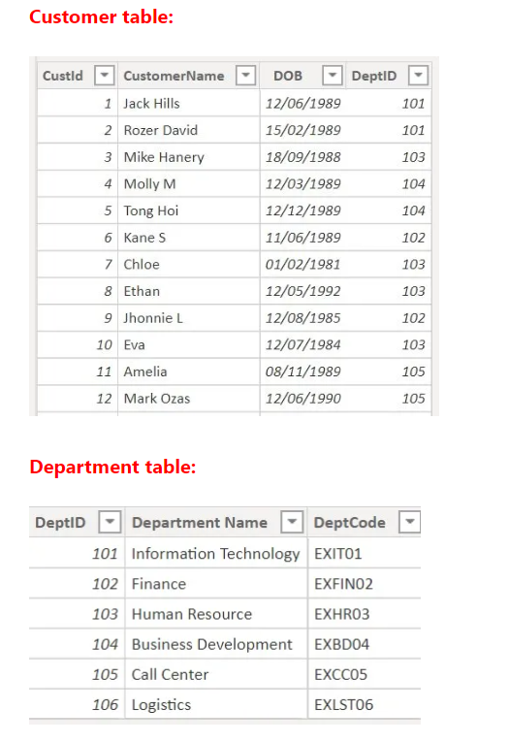
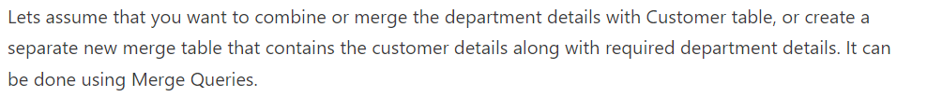
Merge
Merge Queries in Power BI allows you to join two existing tables together based on matching values from one or multiple columns.

Slide 39
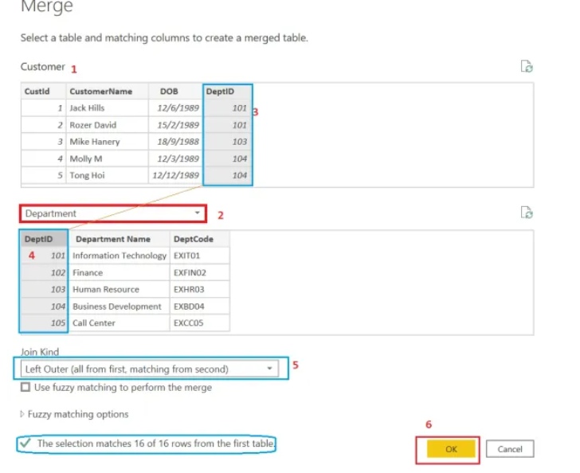
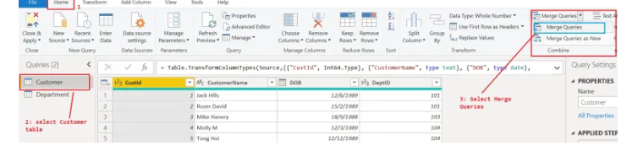
Merge Using Merge Queries:

Slide 40
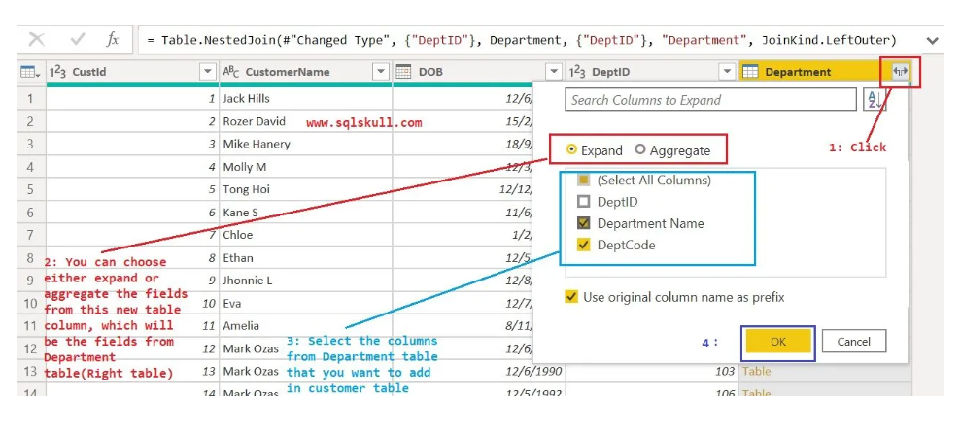
Contd..

Slide 41
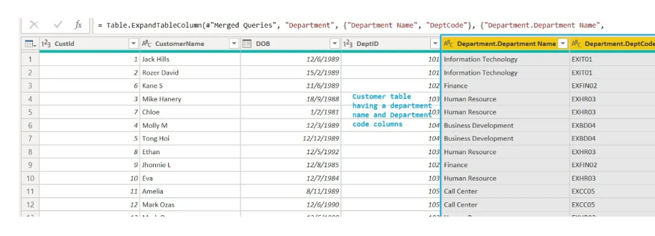
Contd..

Slide 42
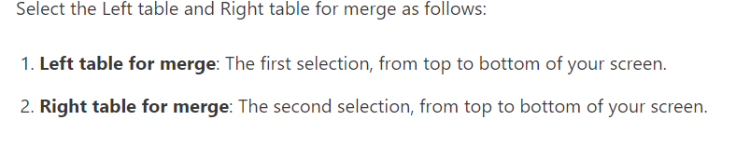
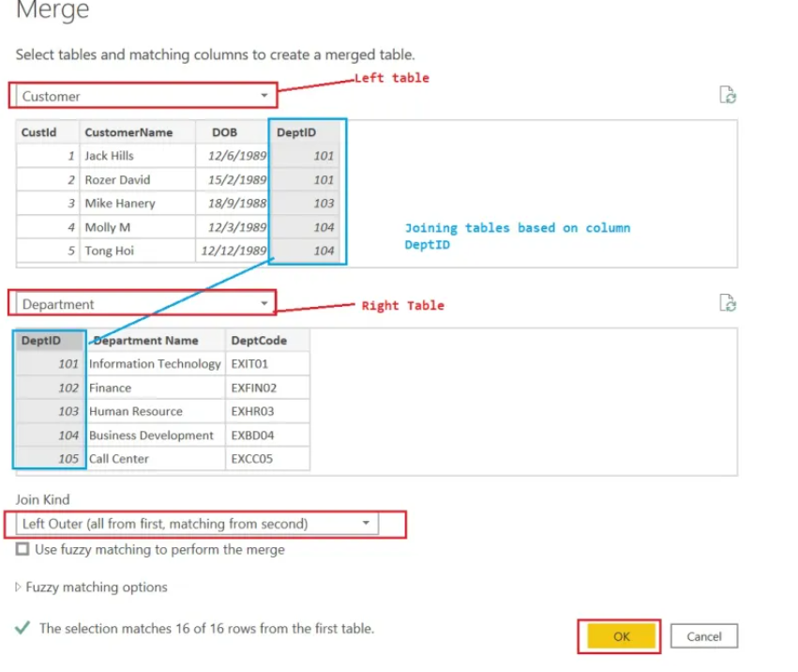
Merge using a Merge as new

Slide 43
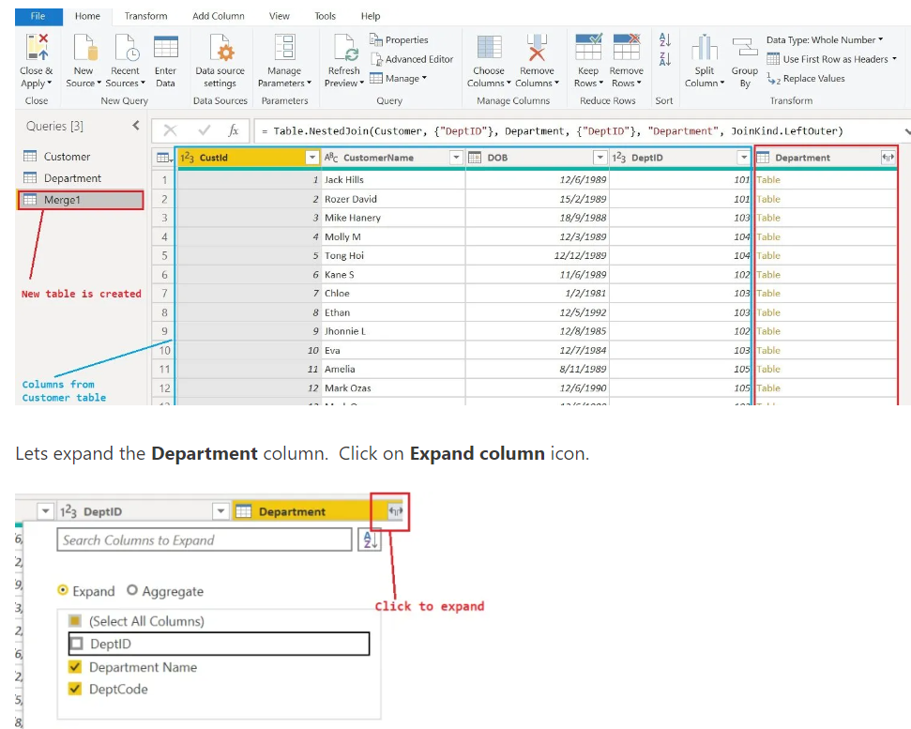
Contd..
Notes:
https://sqlskull.com/2020/11/03/merge-in-power-bi/

Slide 44
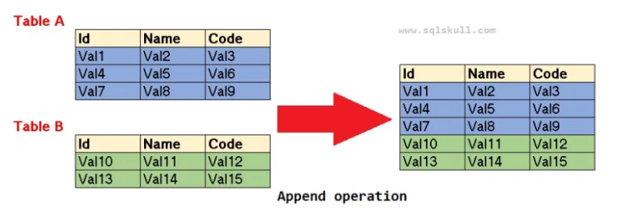
Append Queries
Combining the rows in two or more tables
Combining the two tables with same No.of columns and same set of data types
Append query works on rows
Append query not eliminate duplicates.
Append query is exactly like Union All operator

Slide 45
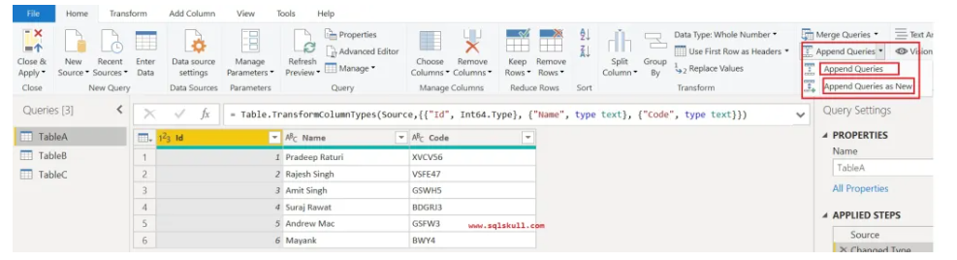
Contd..

Slide 46
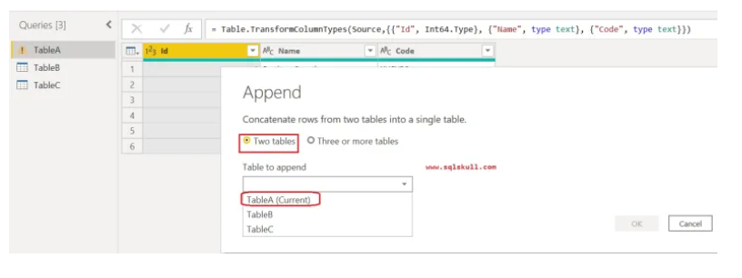
Contd..

Slide 47
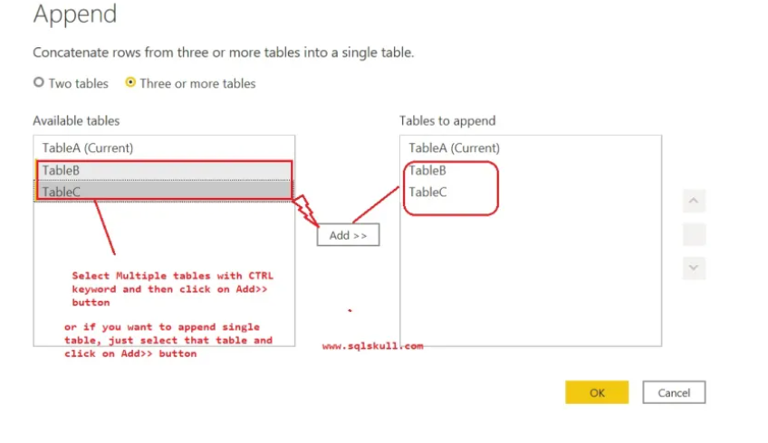
Contd..
Notes:
https://sqlskull.com/2021/03/05/append-queries-in-power-bi/

Slide 48
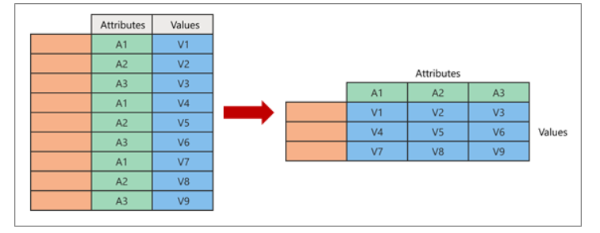
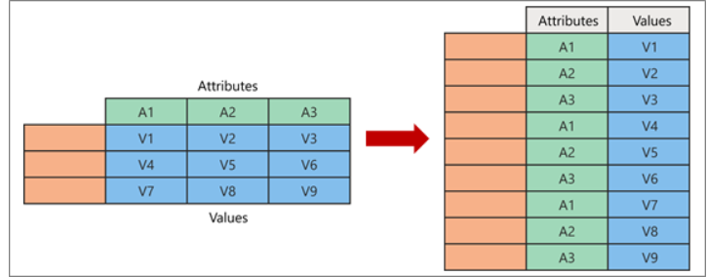
Pivot Column | Unpivot Column
Transform Rows to Columns in Table
Transform Columns to Rows in Table

Slide 49
Basic Filtering
Auto Filter
Filter a Column using Text Filters
Filter a Column using Number Filters
Filter a Column using Date Filters
Filter Multiple Columns
Notes:
https://support.microsoft.com/en-us/office/filter-data-power-query-b5610630-f5bf-4ba4-9217-a628f9b89353

Slide 50
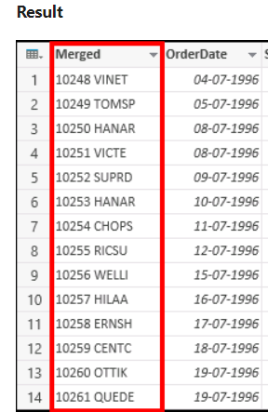
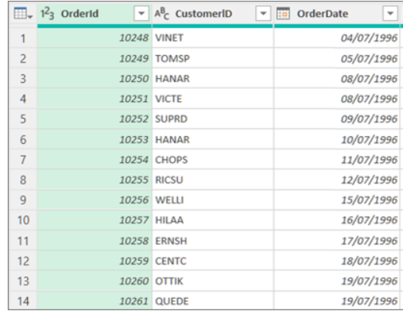
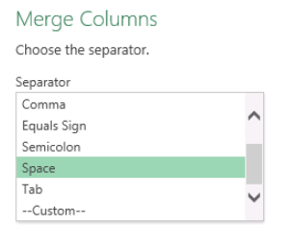
Merge Columns
In Power Query, you can merge two or more columns in your query.
You can merge columns to replace them with one merged column or create a new merged column alongside the columns that are merged.
Notes:
https://yodalearning.com/tutorials/learn-how-to-merge-columns-in-power-query/

Slide 51
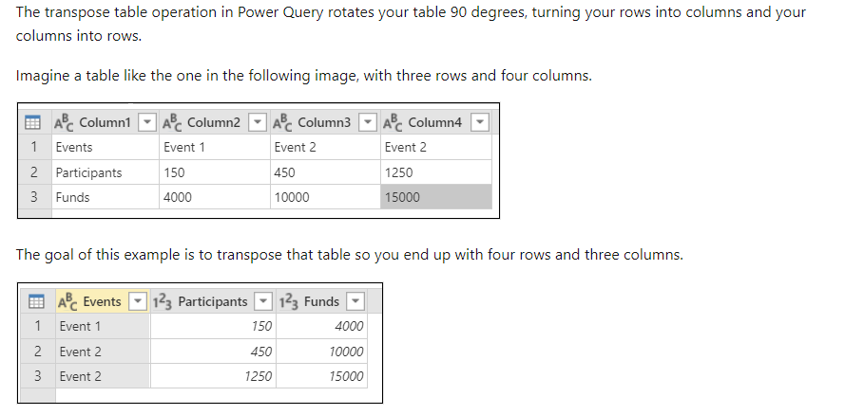
Transpose Columns
Notes:
https://yodalearning.com/tutorials/power-query-helps-transposing-data/

Slide 52
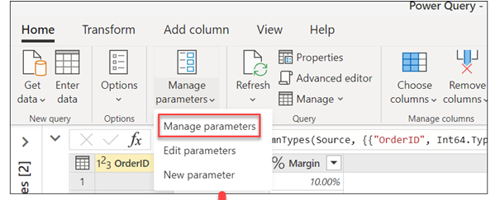
Manage Parameters
A parameter serves as a way to easily store and manage a value that can be reused.
Manage Parameters
Edit Parameters
Create New Parameter
Notes:
https://www.youtube.com/watch?v=aHC7zQqu73g

Slide 53
Automatic Page Refresh
Automatic Page refresh in PBI enables your active report page to query for new data for direct Query.
There are two types of Refresh types
1) Fixed Interval
2) Change detection
It works fine for PBI desktop
Make sure it will work only for premium capacity if you publish it in PBI service
Notes:
https://www.youtube.com/watch?v=oYtey0r1MJs

Slide 54
Power Pivot / Data Modeling
Notes:
https://sqlskull.com/power-bi/power-query-editor-transform-the-data-in-power-bi/

Slide 55
Outlines
Star Schema (Dimension tables + Fact tables)
Importance of Relationships / Types of Cardinality
How to filter the data between 2 tables
How to hide or delete columns from the data model
Establish the relation ships (Removing/ Creating)
Cross Filter
i) Single direction
ii) Both direction

Slide 56
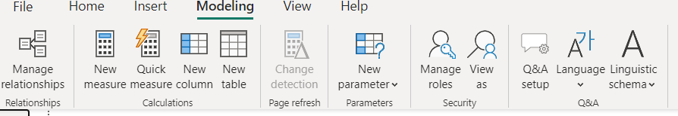
Data Modeling
We often get the data in multiple tables and connect them, and creating a relationship between them is called “Data Modeling.” By creating a relationship between tables, we insist that Power BI know how these tables are connected and create reports from different fields of different tables using Power BI data modeling.
It is one of Power BI’s key strengths because it does not necessarily demand all the data be in a single table. Rather, you can have data in different tables and define a relationship between those tables with a common column.
Notes:
https://www.techrepublic.com/article/excel-tips-every-user-should-master/
https://www.wallstreetmojo.com/power-bi-data-modeling/

Slide 57
Relationship / Cardinality Types
One to one (1:1),
One to many (1:*)
Many to one (*:1),
Many to many (*:*)

Slide 58
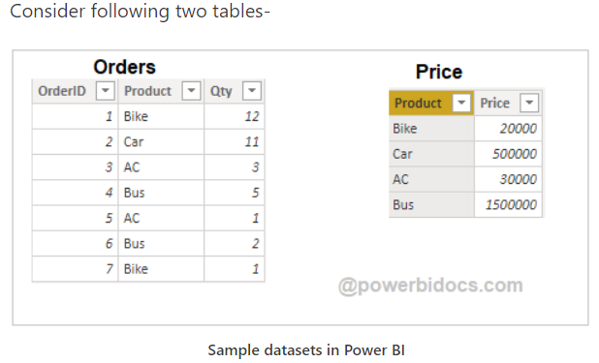
Understand Cardinality of Relationship in Power BI

Slide 59
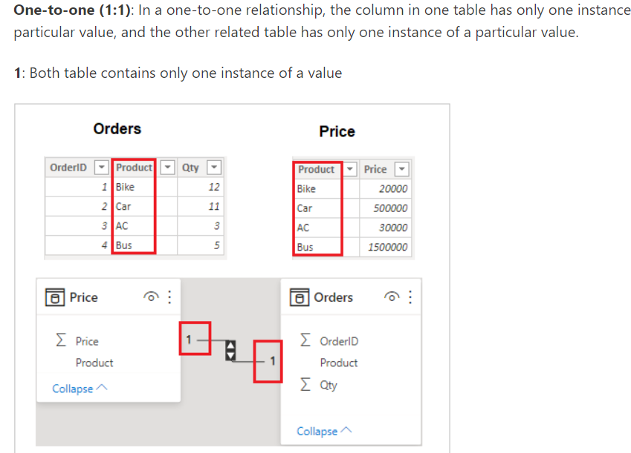
One to One (1:1)
In this type of Relationship both the tables having same number of unique values and no duplicates
Ex : Student details table and student location
Best solution is to merge both tales when we have 1-1 Relationship in order to save memory

Slide 60
One to Many (1: *) or Many to One (* : 1)
Most common type of relationship used in Power BI
In one table having unique values another table having duplicate values with reference to first table (Like PK and FK)
Notes:
https://www.youtube.com/watch?v=jrHHu9duE8c

Slide 61
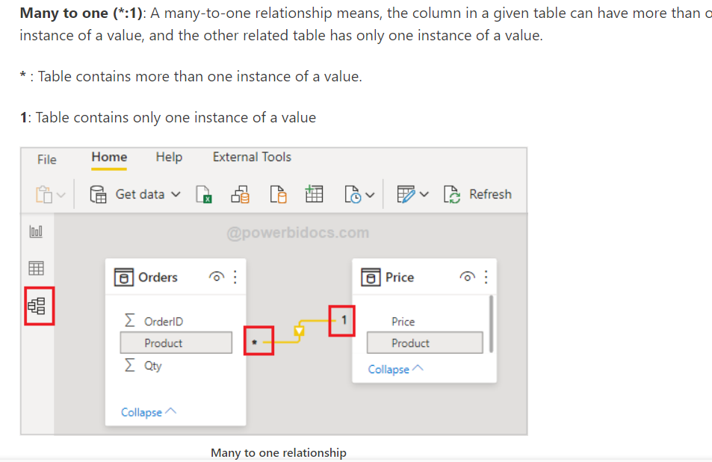
Many to One (*:1)

Slide 62
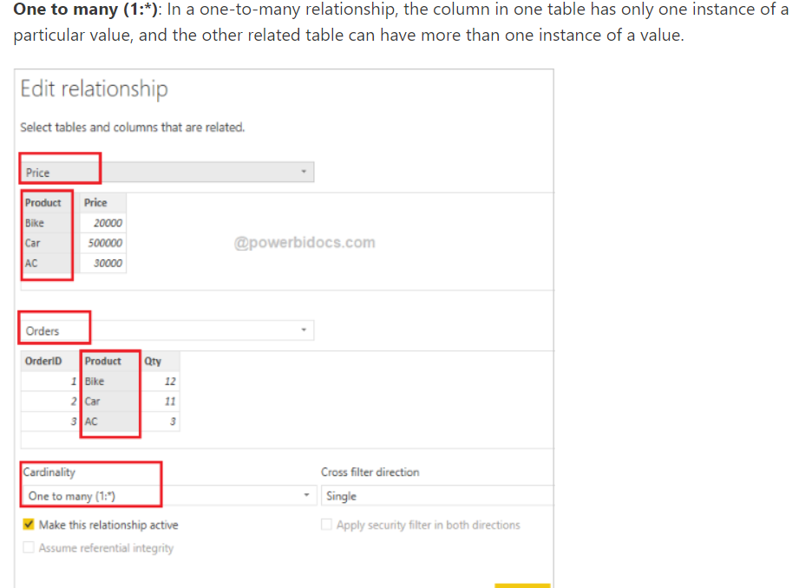
One to Many (1:*)

Slide 63
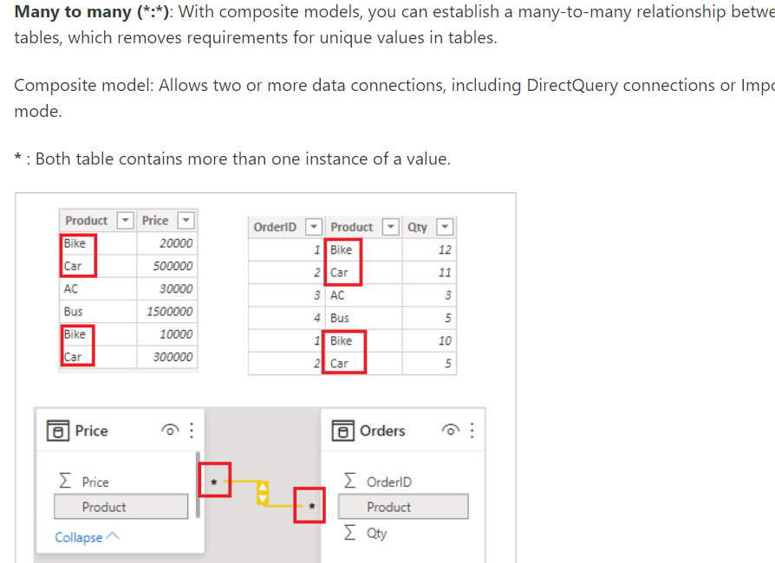
Many to Many (*:*)
Notes:
https://powerbidocs.com/2021/02/15/cardinality-of-relationship-in-power-bi/

Slide 64
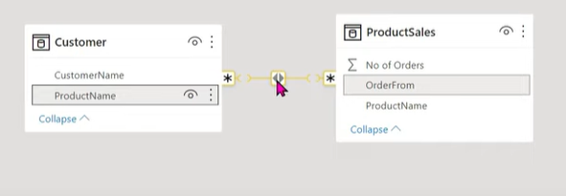
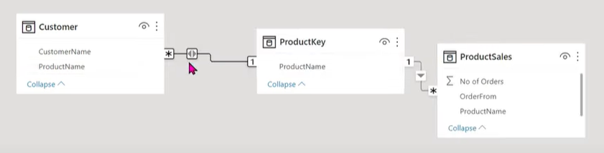
How to handle Many to Many (*:*)
Many-to-Many when it determines neither table contains unique values for the relationship columns.
We can handle these kind of scenarios by using Bridge Table
Bridge Table
Notes:
https://www.youtube.com/watch?v=lAbxusr3kNw

Slide 65
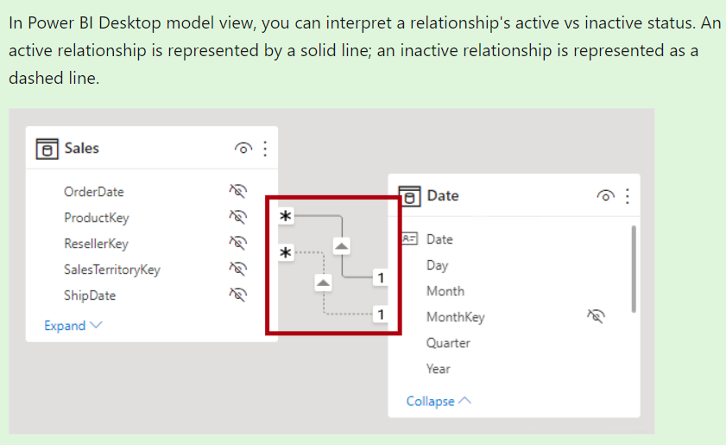
Active / In Active Status
Notes:
https://learn.microsoft.com/en-us/power-bi/transform-model/desktop-relationships-understand

Slide 66
How to active In active state
Active relationship propagate filters to other tables
Inactive relationship, however, only propagate filters when a DAX expression activates (uses) the relationship
Role Playing Dimension
A table with multiple valid relationships between itself and another table is known as a role-playing dimension. This is most commonly seen in dimensions such as Time and Customer.
Use Relationship : This function enables us to define which relationship should be active for a specific calculation.
Syntax: USERELATIONSHIP(<columnName1>,<columnName2>)
Urp= CALCULATE(SUM(InternetSales[SalesAmount]), USERELATIONSHIP(InternetSales[ShippingDate], DateTime[Date]))
Notes:
Imaran shaik Use relationship()

Slide 67
DAX Relationship functions
Cross Filter
Related
Related Table
UseRelationship

Slide 68

Bi – directional cross filtering relationship
Bidirectional cross filtering enables to apply filters on both sides of a table relationship
Notes:
https://radacad.com/what-is-the-direction-of-relationship-in-power-bi
https://www.youtube.com/watch?v=o1ybpYQHj48

Slide 69
Filter Propagation
Direction of a relationship means the way that filter propagates in Power BI.
Both-Directional relationship is one of the ways you can kill the performance of your Power BI Model!
we can use the CROSSFILTER function to change how the cross-filter direction behaves between two columns defined by a relationship.
BiDi:= CALCULATE([Distinct Count of ProductKey], CROSSFILTER(FactInternetSales[ProductKey], DimProduct[ProductKey] , Both))

Slide 70

Power BI Visualizations

Slide 71

Line Chart
It is One of the popular chart in Power BI.
Used to visualize the data according to time.
Represent series of datapoints connected by a straight line.
Example : Stock market analysis
Example :

Slide 72

Area Chart
Area chart is also known as layered chart
Area chart is based on the line chart. The area between axis and line is filled which colors to indicate volume
Uses
Used to draw attention to total value across the trend
Used to see and compare the volume trend across a time series
Example:

Slide 73

Pie Chart
Most common visual in Power bi.
Used to display the high-level information.
Make sure that you should not use pie chart more than 5 values
Example :

Slide 74

Funnel chart
A Funnel chart helps you visualize a linear process that has Sequential connected stages
Ex : Amazon shopping
Each funnel stage represents a percentage of the total. So, in most cases a funnel chart is shaped like a funnel-with first stage largest and each stage will become small compared to previous one
When data is sequential and moves through at least 4 stages
When the no . of items in a first stage is expected to be greater than number in final stage
To track the progress and success of marketing campaigns
Example:

Slide 75

Matrix Table
A Matrix is like a table
A table supports two dimensional and data is flat , meaning duplicate
values are displayed and not aggregated.
A Matrix makes it easier to display data meaningfully across multiple dimensions
You can use drill down in Matrix Visual
Matrix has a stepped layout
You can see subtotal and grand total
Normal Table vs Matrix Table

Slide 76

Ribbon Chart
Ribbon chart is to visualize data and quickly discover which data category has the highest rank (Largest value)
Ribbon chart are effective at showing rank change with the highest value always displayed on top for each time period
By using Ribbon chart, we can see the category rank

Slide 77


Cards and Multi Row Cards
Multi Row Card
2 Types of cards in Power BI
i) Single Cards
ii) Multi-row cards
Single Cards : These cards are used to display a Single number
Alerts we can apply here
Multi Row Cards : These cards are used to display the data in group format or section wise
Alerts doesn’t possible here
Single Card

Slide 78

Column Chart
One of the mostly used chart in Power BI
Column Charts are used to display value for one or multiple categories
These are rectangular in shape and aligned vertically
Ex : Sales volume by Region name

Slide 79

Stacked Column Chart
A Stacked Column chart is like Column chart, the only difference is it is having a Legend.
So that we can analyze the data not only with X and Y axis but also with Legend
This Chart is mainly used to analyze the subcategory wise results

Slide 80

KPI chart
A KPI visual requires a base measure that evaluates to a value, a target measure or value, and a threshold or goal.
A KP dataset needs to contain goal values for a KPI.
If your dataset doesn't contain goal values, you can create them by adding an excel sheet with goals to your data model or PBIX file.

Slide 81

Water fall Chart
Waterfall charts shows a running total as Power BI adds and subtract values.
These charts useful for understanding how an initial value(like sales volume) is affected by series of positive and negative changes.
The columns are color codes so you can quickly notice increases and decreases

Slide 82

Contd..
When to Use Waterfall Chart
To audit major changes-Contributing to the total value
To illustrate the beginning and the ending headcount for your company in a year.
To Visualize how much money, you make and spend each month, and the running balance for your account.

Slide 83

Slicer Visual
Slicers are used to filter the specific data from the report.
Slicers are great choice for when you want to
1) Display commonly used or important filters on the report canvas for easier access
2) Make it easier to see the current filtered state without having to open the dropdown list.
3) Create more focused reports by putting slicers next to important visuals

Slide 84

Donut chart
A doughnut chart is similar to a pie chart in that it shows the relationship of parts to a whole. The only difference is that the center is blank and allows space for a label or icon

Slide 85

Scatter chart
A scatter chart shows the relationship between two numerical values.
A bubble chart replaces data points with bubbles, with the bubble size representing a third data dimension.
To plot two groups of numbers as one series of x and y coordinates.

Slide 86


Map based visualizations
Before creating map, some geographical data is required in your data set to create map.
Example : State, region, city, Longitude, Latitude …. Etc
Two types of Map visualizations are there in PBI
1. Map 2. Filled Map

Slide 87

Line and stacked Column chart
The Line and Stacked Column Chart is a combo charts that combines the Line chart and Column chart together in one visual.
By combining these two visuals together, you can make a very quick comparison between two sets of measures.
The main benefit of this type of chart is that you can have one or two Y axes.

Slide 88
Power BI Desktop – Format

Slide 89
Edit Interactions
Bring forward
Send Backward
Selection
Align

Slide 90

Edit Interactions
By default, all visuals in power bi report page are interactive with each other that means, If you select any value in slicer it filters all other visuals in the report page, in similar way if you select any item in chart visuals that will affect the value of other visual too.
In Power BI, you can control this interaction of visuals using the feature edit interactions.
Notes:
https://sqlskull.com/2020/07/12/edit-interactions-in-power-bi/
https://learn.microsoft.com/en-us/power-bi/create-reports/service-reports-visual-interactions?tabs=powerbi-desktop

Slide 91

Selection
Suppose, I have added 10 visuals in my single page of the report and while publishing this report, I only want to show 8 visuals. I want to hide other two visuals. This is where the selection pane feature comes handy.
Manage the visibility and laying order of objects in report
Format → Selection
View → Selection
Notes:
https://www.c-sharpcorner.com/article/new-power-bi-featu-selection-pane-in-power-bi-preview-feature/

Slide 92

Bring forward / Send Backward
Moving items in Power BI:
1. Moving a text box
2. Moving many items at a time
3. Moving the order of your visuals
4. Copy and paste visuals
5. Align visuals
Notes:
https://databear.com/moving-items-in-power-bi-tips/

Slide 93

Align Visuals
Simply select all the items you want to align and then on the Format Tab at the top, click the Align drop down, then choose the option you want.

Slide 94
Power BI Desktop – Data / Drill

Slide 95
Out lines
Visual Table
Drill Actions
Drill down filters
Drill Down | Drill Up | Drill Through
Data Groups

Slide 96


Drill Through
Using drill through In Power Bi reports you can create a target destination page in your report that focuses on specific entity.
When your report readers right click a data point on other source pages, they will be point to the target page and details are filtered to that context.
Set up Drill through Target page
Notes:
https://www.youtube.com/watch?v=kBNA5FeDUzY

Slide 97

Drill through Button
This button drills through to a page with details that are filtered to a specific context.

Slide 98

Drill Down and Drill UP
Drill down feature in PBI is used to dig the next level of data.
Drill down is used to check the data at granular level (Lowest level)
Drill down activates only if you have the data at hierarchy level(ex: year to day)
Drill down is mainly used for analysis purposes or to identify the trend
Exactly opposite to drill down in drill up
Notes:
https://www.youtube.com/watch?v=rHEKVcGDrpI

Slide 99
Power BI Desktop – View

Slide 100

Outlines
Themes
Page view
Mobile layout
Gridlines | Lock objects
Filters
Bookmarks
Selection
Performance Analyzer
Sync Slicer

Slide 101
Filters
Filters are very powerful features in Power BI
They are mainly used to sort the data based on some selected condition as per the business need.
Filter Types
Visual Level Filter : Filter is applied only on that visual, rest of the visuals will not effect
Page Level Filter : Filters are applied entirely on page itself, all the visuals in the page
will effect.
Report Level Filter (Filter on all pages) : Filter are applied on all pages, all the visuals in
all pages will effect

Slide 102

Demo

Slide 103
Filters vs Slicers
Filters | Slicers
Filters are one of the feature in PBI not a visual | Slicer is one of the visual in PBI
In Filters there are Visual level, Page level and report level filters are there | In Slicers there is no feature only sync slicers are present
In filters report level filters is used to filter all the pages | In Slicers " Sync Slicers" are used to filter/sync the data across all pages
Filters support "Measures" | Slicers will not support the "Measures"
In Filters basic, advanced filters are there where you can filter topn n (like top 2 etc) | In Slicers there is no such concept
Filter does not affect performance as slicers | Slicers slow down the performance of the report

Slide 104


Sync Slicers
Sync your data across all the pages, Sync slicers is the best one.
Before applying Sync slicers Normal slicer should enable
Click on view menu and there will be sync slicers option will be present

Slide 105


Selection Pane
How to use the selection pane in Power BI
1. Select visuals
2. Hide and Show visuals
3. Rename visuals
4. Order visuals
5. Group visuals
Notes:
https://databear.com/selection-pane-in-power-bi/

Slide 106


Performance Analyzer
Performance Analyzer is an easy and accessible way to track the performance of a Power BI report during the development process in Power BI Desktop.
Performance Analyzer can help you identify visuals that affect the performance of your reports and identify the reason for the impact.
In Power BI Desktop select the View ribbon, and then select Performance Analyzer to display the Performance Analyzer pane

Slide 107

Bookmarks
Bookmark is a Power BI feature
Capture the current state of your report page.
This includes settings you have made to the filters, slicers and visuals on that page
Bookmarks make report page look more meaningful
Notes:
https://towardsdatascience.com/bookmarks-in-power-bi-what-this-data-mean-866857fe719b
https://www.youtube.com/watch?v=3G1Mj9X-pyA

Slide 108



Bookmarks with shapes and Buttons
To make Bookmarks user friendly we are creating shapes and Buttons.
PBI Desktop -→ Insert -→ Buttons
PBI Desktop -→ Insert -→ Shapes
Notes:
https://www.youtube.com/watch?v=2Z2gwJWu_oo

Slide 109
Power BI Desktop – Insert

Slide 110

Out lines
Pages
Visuals
AI Visuals
Power platform
Elements
Sparklines

Slide 111

Decomposition Tree
The decomposition tree visual in Power BI lets you visualize data across multiple dimensions.
It automatically aggregates data and enables drilling down into your dimensions in any order.
Notes:
https://www.youtube.com/watch?v=rXVF7YOOX5A

Slide 112

Key Influencers
Key influencers shows you the top contributors to the selected metric value.
Top segments shows you the top segments that contribute to the selected metric value

Slide 113

Q & A
The Q&A visual allows users to ask natural language questions and get answers in the form of a visual. Consumers can use it to quickly get answers to their data. Designers can also use it to create visuals quickly.

Slide 114
Power BI Desktop – Home

Slide 115

Out lines
Data
Queries
Insert
Calculations
Share

Slide 116
Power BI Desktop – Help

Slide 117

Out lines
About
Help
Community
Resources

Slide 118
Q
A
Thank you for joining us!
For more visit Trellance.com

